Slide 1
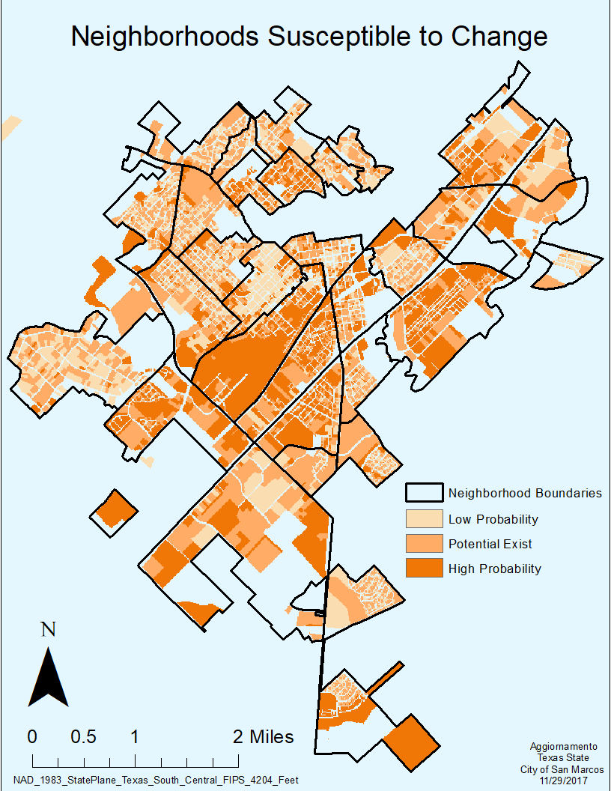
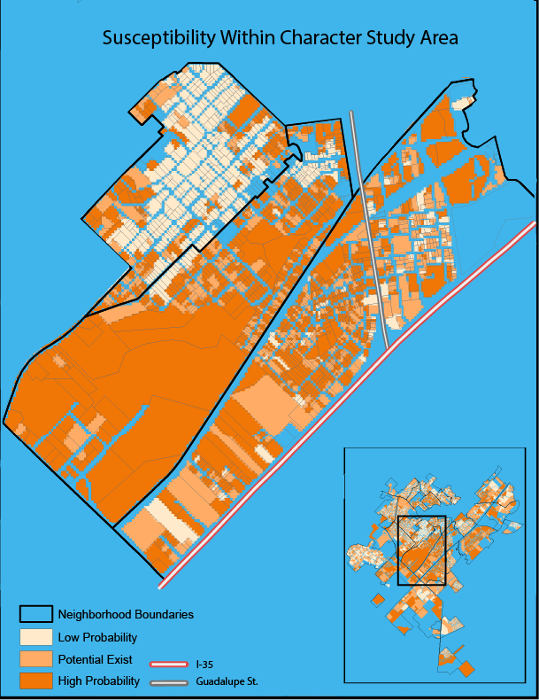
Susceptibility to Change Analysis in San Marcos
Aggiornamento
Problem
Conclusion
In conclusion, the city of San Marcos has potential to continue to grow as it is influenced by factors such as Texas State University and its proximity to two major Texas cities. While there appears to be room for areas to supply the demand of future changes that may occur, it is important for the city to plan accordingly. These results illustrate areas that can be focused on to better manage development and redevelopment. However, due to the factors that were into consideration and some of the limitations, it would be wise to continue to run these kinds of analysis introducing new factors and more data to compare results. This allows for more in-depth analysis that may serve better use. We hope that these results not only meet our client’s expectations and needs, but set forth a foundation for future analyst to take this model and make it better.
Located half way between two of Texas largest cities, Austin and San Antonio, San Marcos, TX is one of the fastest growing cities in the United States. In 2015, the U.S Census recognized it as the fastest growing city in the country for the third year in a row. With such rapid growth occurring, it is common to see redevelopment begin to occur, in order to accommodate for the growing population.
Purpose
Results
The results of this project serve as indicators to identify areas that have a high probability to be redeveloped, versus those that are stable. Identifying these areas, allows the city to guide development and redevelopment projects in such a way that the goals of the preferred scenario are still met.
Methods
To conduct our analysis, we used an overlay tool, specifically weighted sum. This tool allowed us to create several layers, each one corresponding to a factor that can influence a location to be developed or redeveloped. The tool then adds the overlaying values of the layers from the input.
Factors included were:
Owner Occupancy
Zoning
Walk score
Land to Improvement Ratio
Public Concern
Historic Districts

